Slide 1


Introduction to Basic Robotics Parts/Systems
Cass Lake Bena Robotics
Team 3134 & Team 3275

Slide 2
What We Will Cover
Drivetrains
Electrical System
Operator Interface

Slide 3
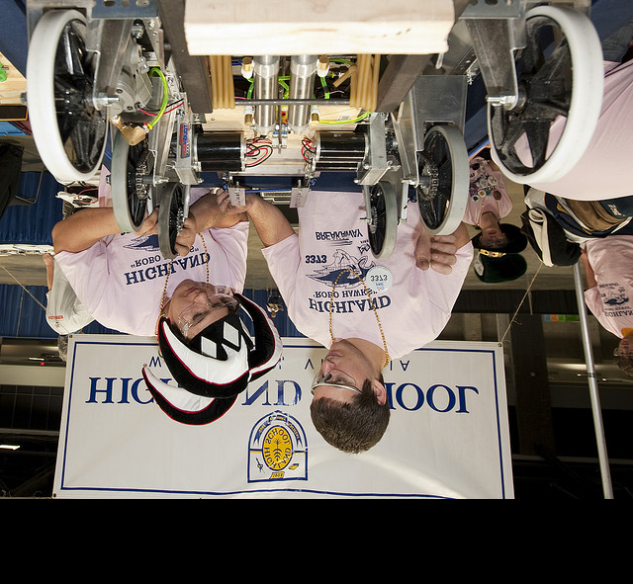
Drive Systems

Slide 4
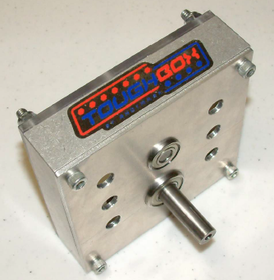
Gearbox
Toughbox
Transmission
Gear Reducer
Reduces speed of motor
output
Increases your output
torque
Toughbox

Slide 5
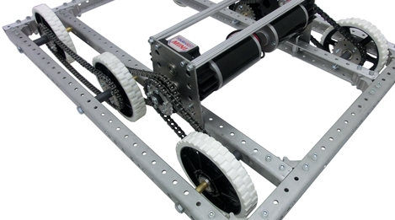
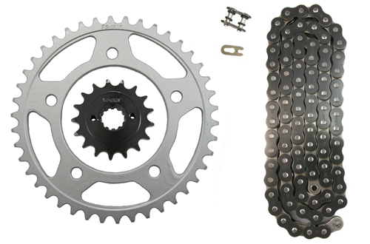
Chains, Sprockets, Hubs
Connect motors to wheels

Slide 6
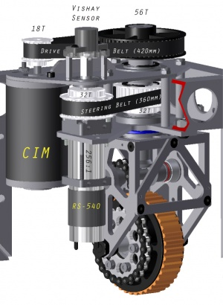
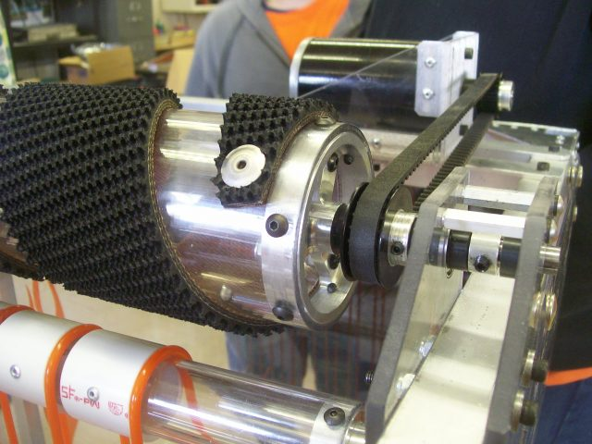
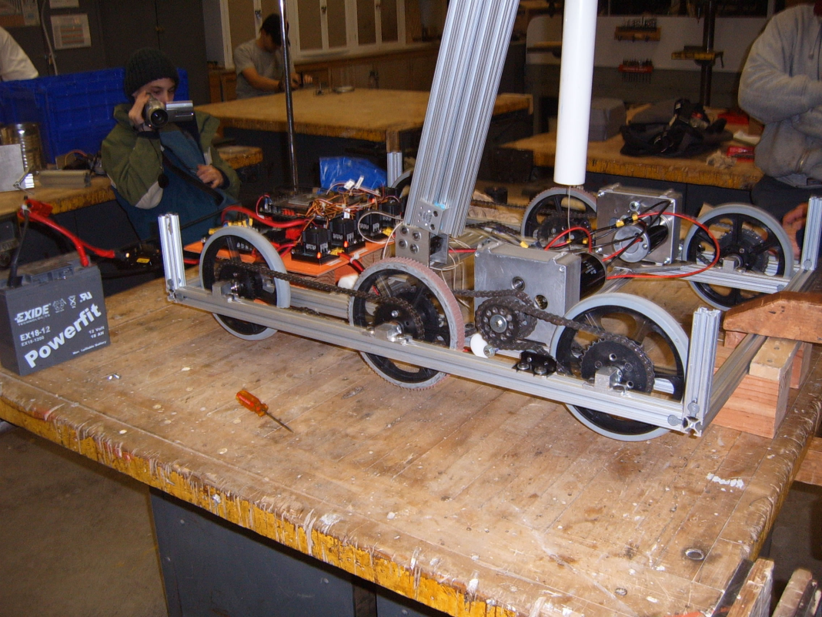
Drive Systems
Use combinations of gearboxes, motors, and wheels to design a drive system.

Slide 7
Drive Systems
There are many varieties of drive systems:
Tank Drive
4 Wheel Drive
6 Wheel Drive
Mecanum Drive Systems
Swerve Drive Systems
Holonomic Drive Systems

Slide 8
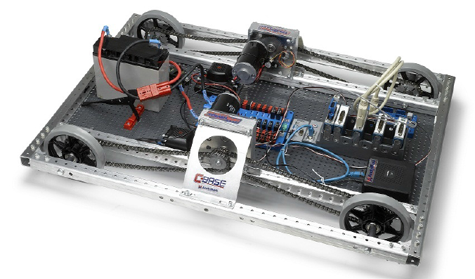
4 Wheel Drive

Slide 9
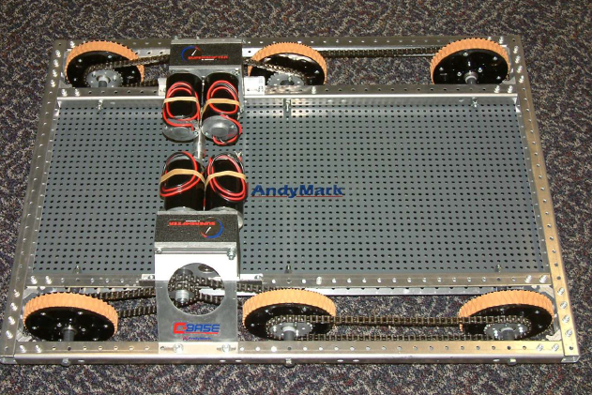
6 Wheel Drive

Slide 10
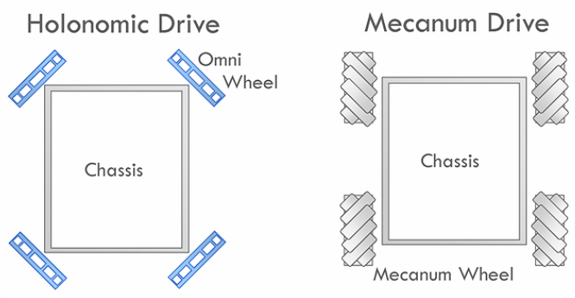
Mecanum Drive System

Slide 11
Holonomic Drive System

Slide 12
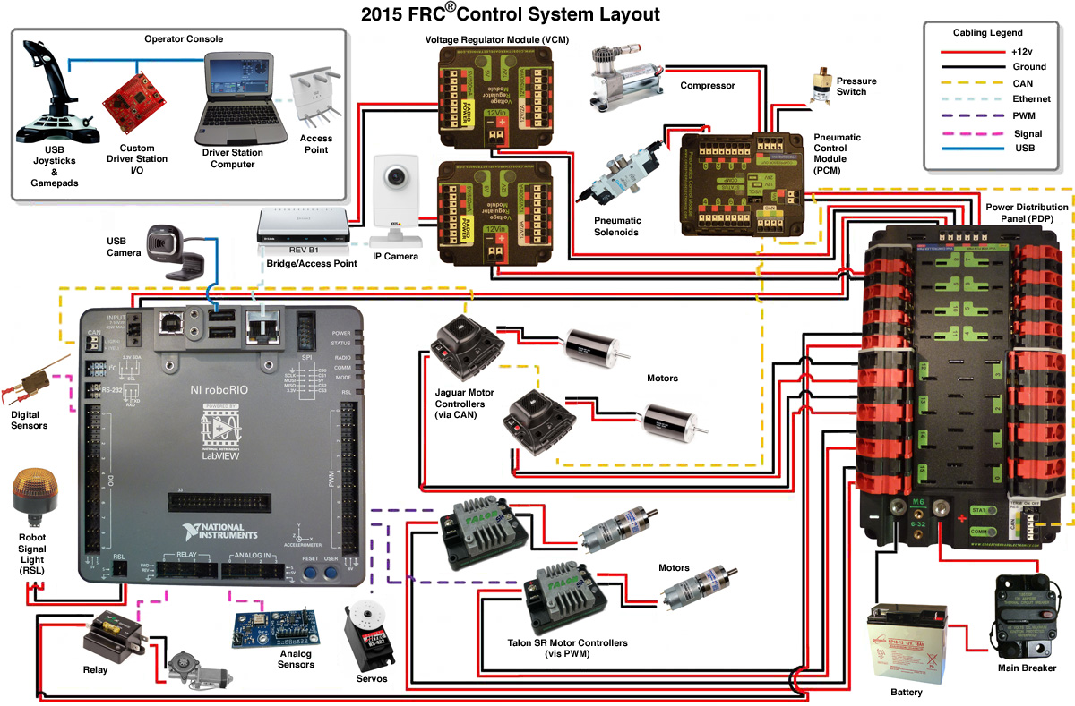
Electrical Diagram

Slide 13
Electrical Diagram

Slide 14
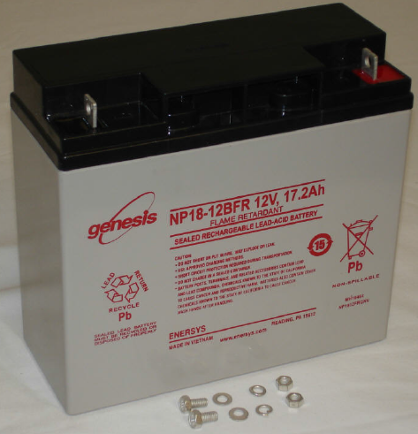
Battery
EnerSys NP 18-12
Only robot power
source

Slide 15
Electrical Diagram

Slide 16
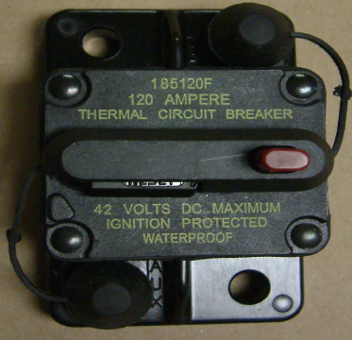
120 Amp Breaker
Main Breaker
Power Switch
All current runs through this component

Slide 17
Electrical Diagram

Slide 18
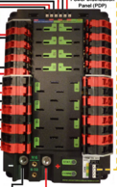
Power Distribution Panel or PDP
Breaker Panel
Power Board
Distributes power to the rest of the robot

Slide 19
Electrical Diagram

Slide 20
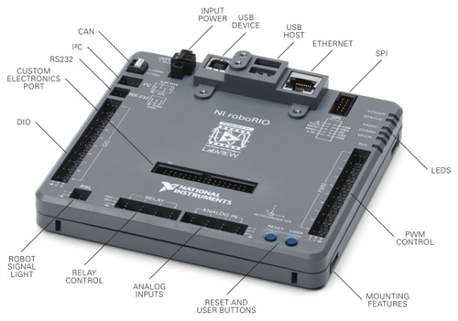
RoboRIO
NI roboRio
The "brain"
The "computer"
Programmable microcontroller

Slide 21
Electrical Diagram

Slide 22

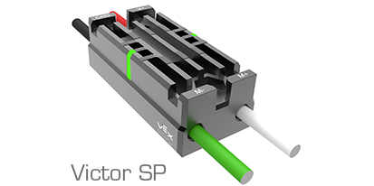
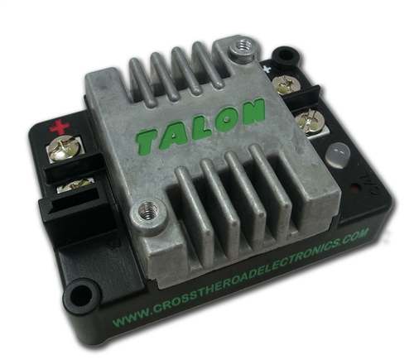
Speed Controllers
Lets roboRIO regulate voltage to motors
Both can be controlled with the PWM ports
Jaguar's can be controlled via the CAN bus as well

Slide 23
Electrical Diagram

Slide 24
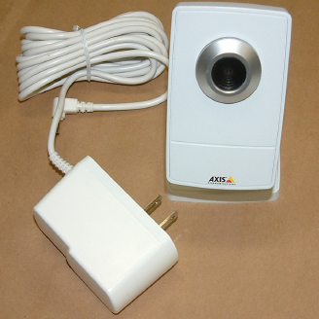
Camera
AXIS M1011 or 206
Provides vision capabilities to robot
Paired with algorithms donated by NI

Slide 25
Electrical Diagram

Slide 26
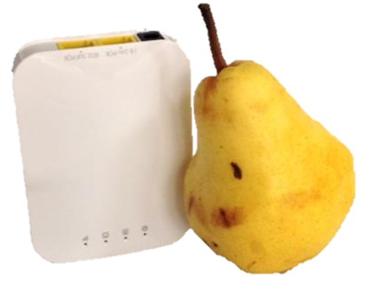
Wireless Bridge
Open Mesh’s OM5P-AN dual band access point
Also called radio or gaming adapter lets the roboRIO communicate with the field and controls

Slide 27
Electrical Diagram

Slide 28
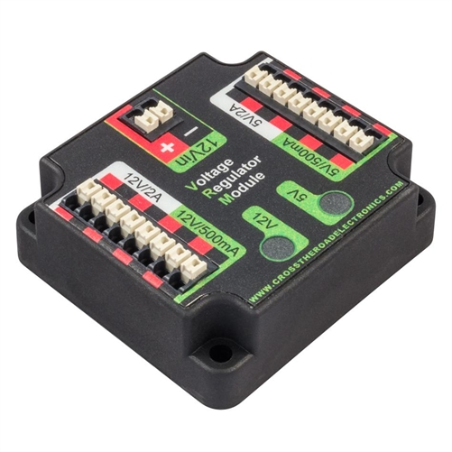
Voltage regulator module or VRM
Regulates voltage to components regardless of battery voltage

Slide 29
Electrical Diagram

Slide 30
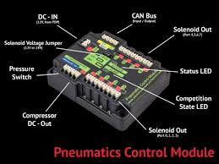
Pneumatic control module or PCM
Controls solenoids, compressor and has a integrated pressure switch

Slide 31
Electrical Diagram

Slide 32
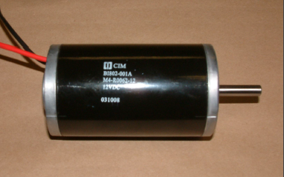
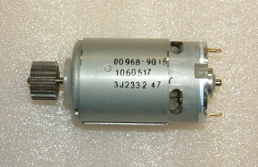
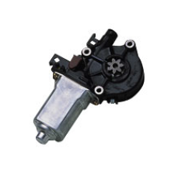
Motors
CIM Motor (Chiaphua)
Fisher Price Motor
Denso Window Motor

Slide 33
Electrical Diagram

Slide 34
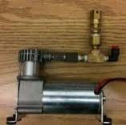
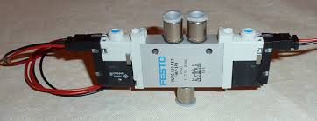
Compressor and Solenoid
Compressor supplies air to pneumatic devices
Solenoid regulates air movement

Slide 35
Electrical Diagram

Slide 36
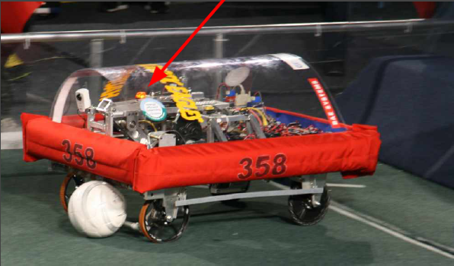
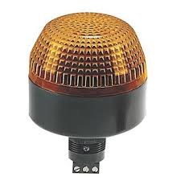
Signal Lamp
Solid ON = Good
Slow Blink = Disabled
Fast Blink = No Communication

Slide 37
PWM Cables
Also called a servo cable
Most used signal cable
PWM
Digital I/O
IFI Spike

Slide 38
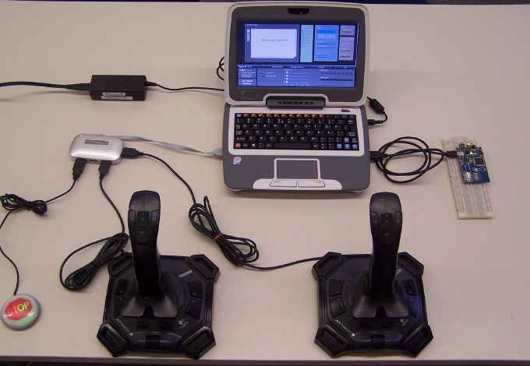
Operator Interface

Slide 39
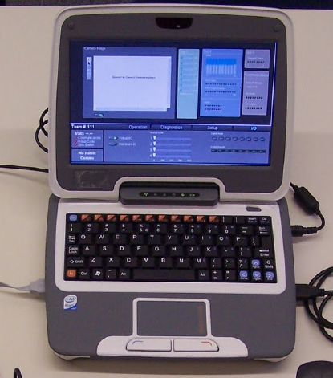
Classmate PC
Laptop computer
Newest component
Main part of the driver
station
Live feedback through customizable dashboard

Slide 40
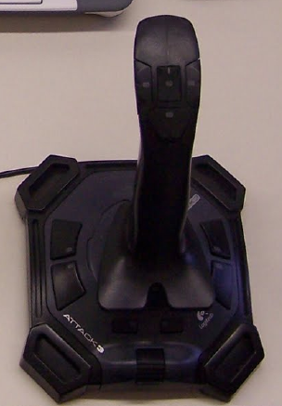
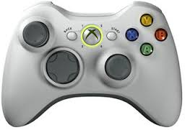
Joysticks

Slide 41
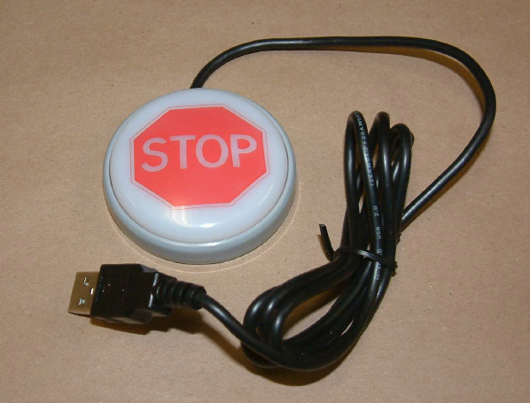
Stop Button

Slide 42



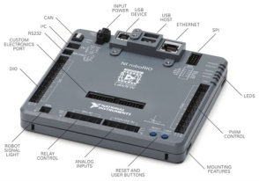
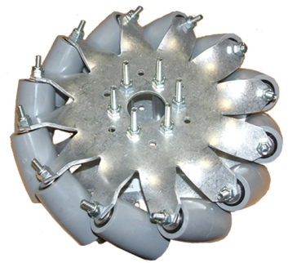
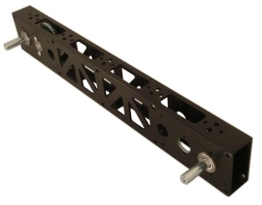

Signal Flow

Slide 43








Brought to you by:
Aircorps Aviation

